Slide 1
Nuclear Fuel Performance
NE-533
Spring 2024

Slide 2
Last time
Five families of fission products, which change the fuel behavior
soluble oxides, insoluble oxides, noble metals, volatiles, noble gases
Fission gas is released in three stages
Fission gas production and diffusion to grain boundaries
Grain boundary bubble nucleation, growth, and interconnection
Gas transport through interconnected bubbles to free surfaces
Fission gas release models are used to understand fission gas experiments and to predict gas release for fuel performance codes
Spherical grain models predict a fraction of gas release for post-irradiation annealing or for in-pile gas release
Booth model takes Stage 1 into account

Slide 3
Modeling in-pile release
The initial gas concentration is 0
Gas is produced due to fission, where y is the chain yield (y = 0.3017 for Xe and Kr) and the fission rate
Gas can also decay, where λ is the decay constant
If we only consider stable stable products, λ = 0
For in pile release, the fraction is equal to
After solving with with a Laplace transform
The total gas production is gas atoms/cm³
Release
Gas atoms
Grain boundary
ICs and BCs
c_{g}(r, 0) = 0
c_{g,r}(0, t) = 0
c_{g}(a, t) = 0 (release)

Slide 4
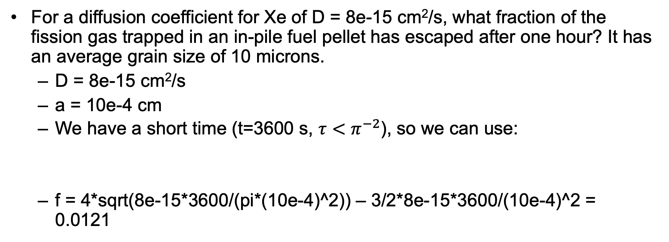
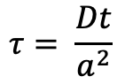
Example
For a diffusion coefficient for Xe of D = 8e-15 cm²/s, what fraction of the fission gas trapped in an in-pile fuel pellet has escaped after one hour? It has an average grain size of 10 microns.
D = 8e-15 cm²/s
a = 10e-4 cm
We have a short time (t=3600 s, $τ<π^{−2}$), so we can use:
f = 4*sqrt(8e-15*3600/(pi*(10e-4)^2)) – 3/2*8e-15*3600/(10e-4)^2 = 0.0121
$$τ= \frac{Dt}{a^{2}}$$

Slide 5
As time progresses, both the fraction released and the produced gas increase

Slide 6
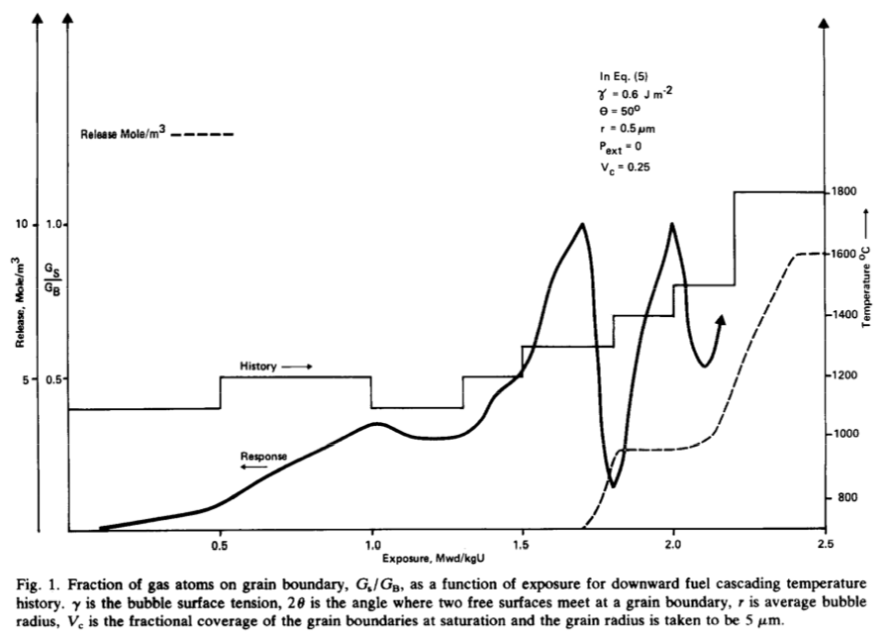
Forsberg-Massih model
The Booth model ONLY considers stage one of fission gas release
Two stage Forsberg-Massih mechanistic model
Considers intragranular diffusion diffusion to grain boundaries (stage 1)
Also, grain boundary gas accumulation, resolution back into grain, saturation (stage 2)
Assumes that once the bubbles on the grain face are interconnected, it is released (no stage 3)

Slide 7
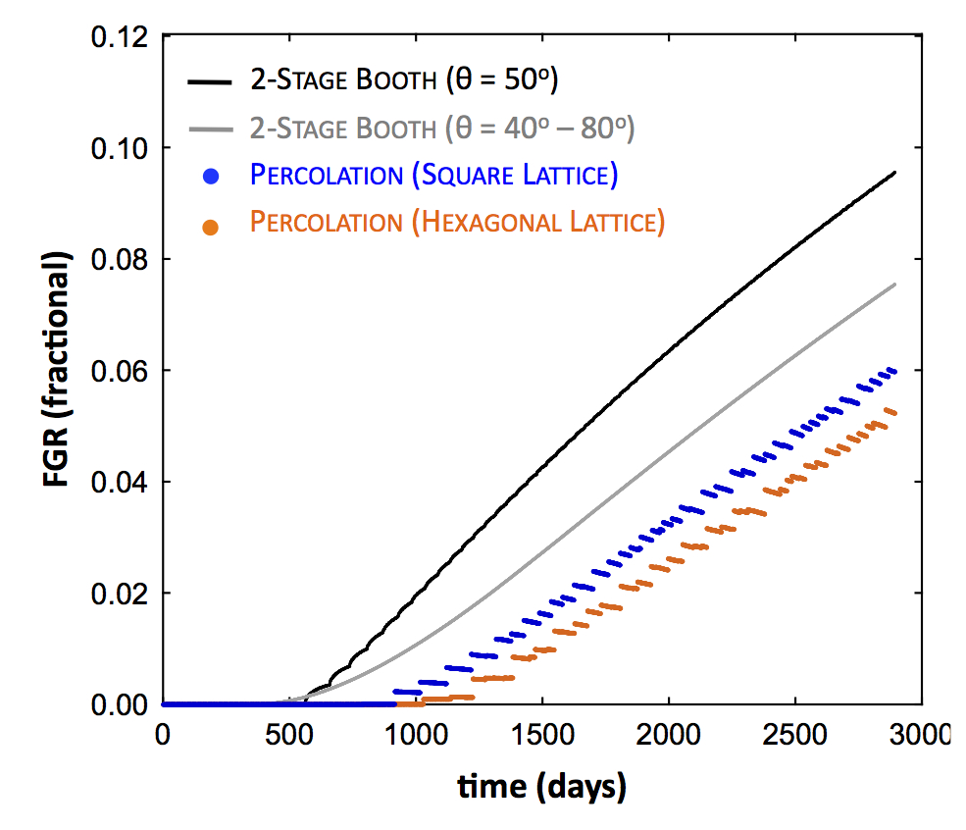
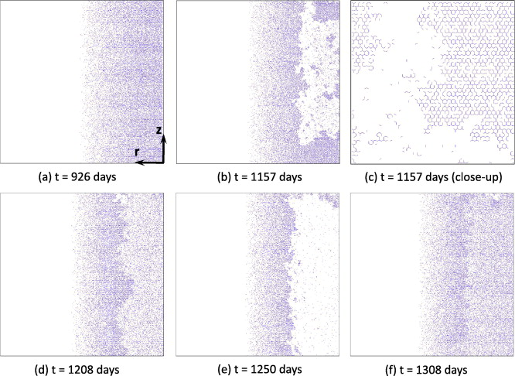
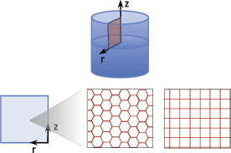
Forsberg-Massih model
2-stage F-M model over-predicts gas release because it neglects grain boundary bubble percolation (Stage 3)
Millett, Tonks, and Biner. JNM, 424.1 (2012): 176-182.

Slide 8
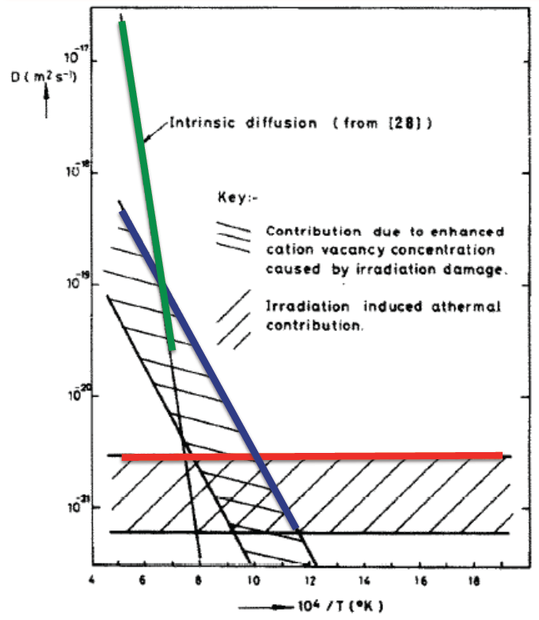
Gas diffusion
The diffusivity of the fission gas depends on temperature and on irradiation
Experimental data shows three different regimes for the diffusivity
D = D₁ + D₂ + D₃ cm²/s

Slide 9
Gas diffusion
The effective fission gas diffusivity is slower due to trapping by intragranular bubbles
As the gas atoms diffuse towards the grain boundary, some are trapped by the small intragranular bubbles
Some are later knocked out by energized particles (called resolution)
The effective diffusion constant depends on the trapping rate r_{t} and the resolution rate r_{r}

Slide 10
Fuel Swelling/Dimensional Change

Slide 11
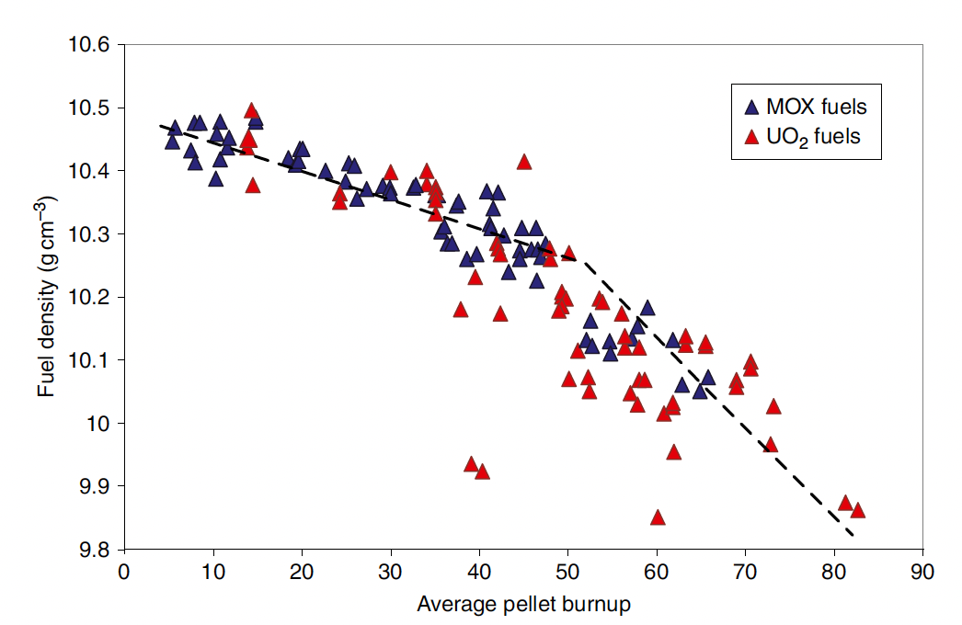
Fuel changes size and shape under reactor operation
Thermal expansion:
increase in volume, decrease in density, caused by increasing temperature
Densification:
Decrease in volume, increase in density, caused by shrinking of porosity left after sintering
Swelling:
Increase in volume, decrease in density, caused by fission products
Irradiation Creep:
Change in shape, constant density, occurs with applied stress less than σ_{y}

Slide 12
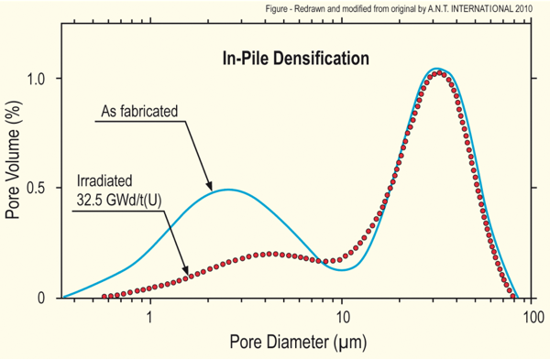
Densification
Densification takes place during initial 5 - 10 MWd/kgU
Small, as-built pores close due to effects of fission spikes and vacancy diffusion
Large pores stable (in absence of large hydrostatic stress)
Empirical correlation for densification is a function of
β - Burnup (in FIMA)
Δρ₀ – Total densification that can occur (a common value is 0.01)
β_{D} – Burnup at which densification stops ( a common value is 5 MWD/kgU)
C_{D} = 7.235 − 0.0086 (T(°C) − 25) for T < 750°C and CD = 1 for T ≥ 750 °C
[Maier et al, 1988]

Slide 13
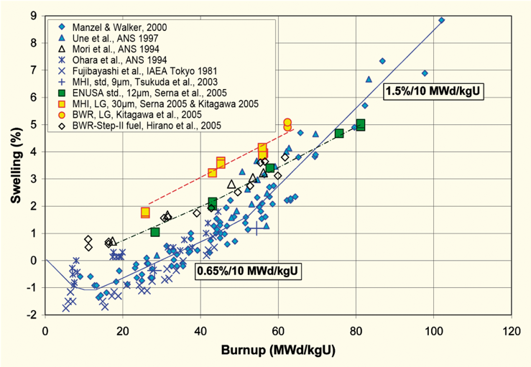
Fission product induced swelling
Fission product swelling results from three changes in the fuel microstructure
Solid swelling: Accumulation of soluble and insoluble fission products in fuel matrix
Gaseous swelling: Accumulation of gaseous and volatile fission products in intragranular and intergranular pores
High burnup swelling: Restructuring of pellet rim with the accumulation of fission gas in a large number of small pores
after Garzarolli in [Rudling et al, 2007]

Slide 14
Solid fission product swelling
The solid fission product swelling model is a function of:
β – Burnup (in FIMA)
ρ – Initial UO₂ density (g/cm³)
Includes contributions from soluble oxides, insoluble oxides, and metallic precipitates

Slide 15
Gaseous fission product swelling
Gaseous swelling varies strongly with temperature, fission rate and stress
T < 1000K
Fission gas atoms remain in fuel matrix or collect in small, isolated, intragranular pores (<1 nm)
Intragranular pore size limited by fission spikes that drive gas back into fuel matrix
Gaseous swelling constrained by fission gas release
T = 1000 to 1700 K
Swelling takes place at hot interior of pellet
Gas atoms in fuel matrix diffuse to grain boundaries and collect in pores
Gas pressure causes bubbles to increase in size and to coalesce into larger pores
Gaseous swelling opposed by applied stress
Gaseous swelling also constrained by fission gas release

Slide 16
Total change in volume
The total change in volume is found by adding all components of dimensional change
ε_{tot} = ε_{th} + ε_{D} + ε_{sfp} + ε_{gfp}
Example:
fission rate = 2.5e13 f/(cm³ s)
T(fuel) = 1400 K
T_{ref} = 300 K
For densification: Δρ₀ = 0.01 and β_{D} = 5 MWD/kgU
Total time: 2 weeks

Slide 17
Example

Slide 18
The overall swelling behavior depends on temperature

Slide 19
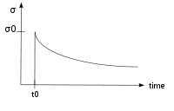
Creep
Creep is a general mechanism for plastic deformation that occurs over time when σ < σ_{y}
Consider a heated metal beam so it expands some distance dx
We then fix it between two walls and let it cool down
Because σ < σ_{y}, that stress remains constant
In creep, defect diffusion is induced by the stress to cause permanent deformation and reduce the stress
Therefore, creep
Occurs over time
Increases with increasing number of diffusing defects
High temperature (thermal creep)
Irradiation (irradiation creep)
x
x+dx
σ = E ε

Slide 20
Creep
General creep equation:
Creep can be caused by various microstructural mechanisms
Bulk Diffusion (Nabarro-Herring creep)
Atoms diffuse (high T), causing grains to elongate along the stress axis
Q = Q(self diffusion), m = 1, and b = 2
Grain boundary diffusion (Coble creep)
Atoms diffuse along grain boundaries to elongate the grains along the stress axis
Q = Q(grain boundary diffusion), m = 1, and b = 3
Dislocation creep
Dislocations glide under a high stress
Dislocations climb due to defects to avoid obstacles
Q = Q(self diffusion), m = 4–6, and b = 0

Slide 21
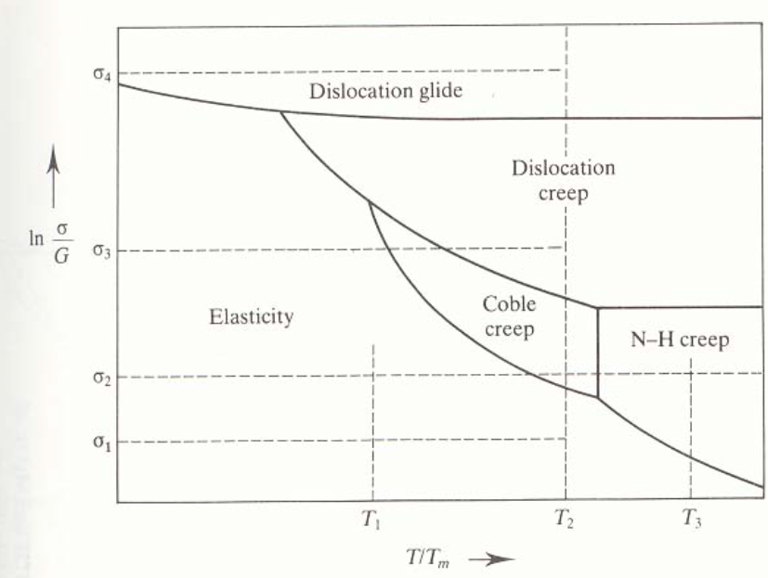
Different creep mechanisms are active for different combinations of stress and temperature

Slide 22
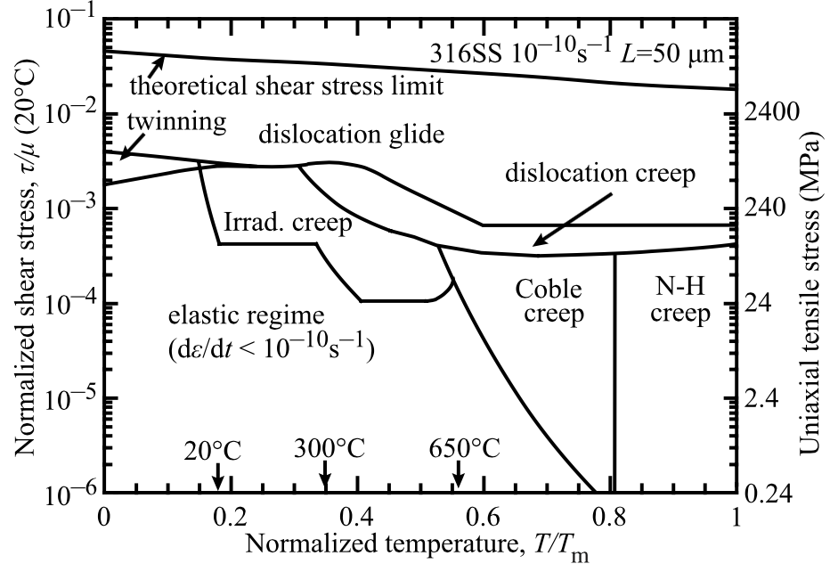
The behavior of creep changes in irradiated materials

Slide 23
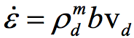
Irradiation and Creep
Irradiation accelerates creep, causing it to be significant at lower temperatures
Irradiation has little effect on diffusional creep, but it accelerates dislocation creep in cubic materials
The dislocation creep rate can be written as
ρ_{d}^{m} is the density of mobile dislocations
b is the burgers vector
v_{d} is the dislocation velocity
Gliding dislocations quickly get pinned by obstacles
As the dislocations absorb defects created by irradiation, they climb to different slip planes to avoid the obstacles
More interstitials are absorbed than vacancies due to the higher sink strength for interstitials

Slide 24
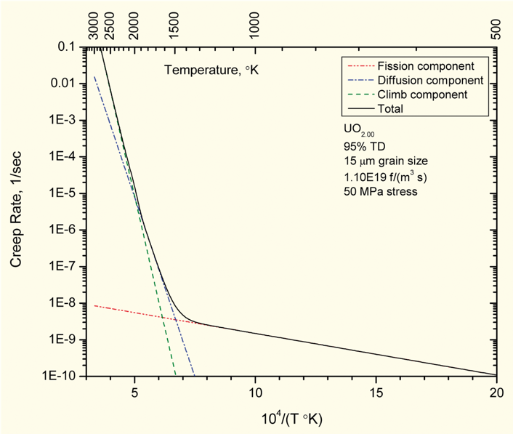
Fuel Creep
Like other materials, the fuel also undergoes creep
The fuel creep (In UO2) is a combination of diffusion creep and irradiation creep
It is expected that fuel creep plays a major role in dimensional change in metallic fuels, largely via N-H and Coble creep, but still unproven experimentally and no good creep models exist for metallic fuels

Slide 25
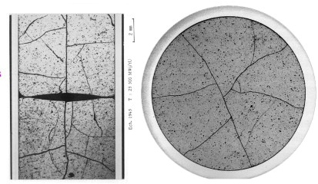
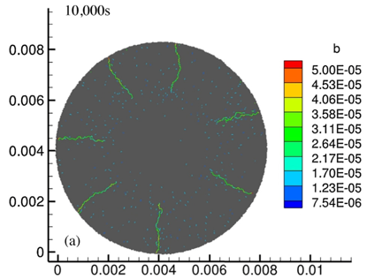
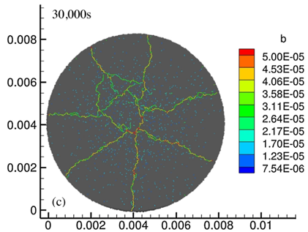
Fracture
UO₂ pellets fracture during changes in temperature due to large thermal stresses
Fracture results in:
Increased gap reduction
Reduced thermal conductivity
Increased avenues for fission gas release
Fracture has been typically modeled in two ways:
Empirical relocation model that is a function of burnup
Semi-empirical smeared cracking model
Modern methods provide means of modeling discrete cracks
Radial cracks partially penetrate the pellet during temperature increase
Full cracking occurs when the temperature decreases

Slide 26
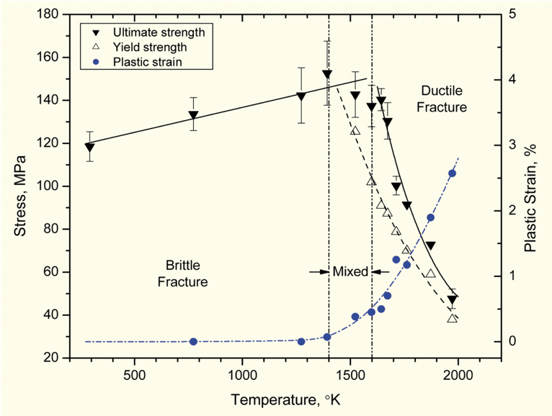
Fracture
The fracture behavior of the fuel is fairly complicated
Fracture strength varies with grain size (G)
σ_{frac} = G^{-m}σ_{frac, ref}, m = 0.04 – 0.05 (vs. m ~ 0.5 for metal)
Increasing grain size from 10 μm to 100 μm reduces σ_{frac} by ~10%
Ductility transition temperature is lower in-reactor than in thermal tests
Fracture strength is ~10× higher in compression than in tension
Load-deformation behavior strongly affected by creep under in-reactor conditions

Slide 27
Summary
Many materials models for fuel are empirical and correlated to burnup
Fuel pellets change shape due to
Thermal expansion (increase in volume)
Densification (decrease in volume)
Swelling (increase in volume)
Creep (volume stays the same)
Fracture also decreases the gap, as fractures pieces shift outward

Slide 28
Zirconium Cladding

Slide 29
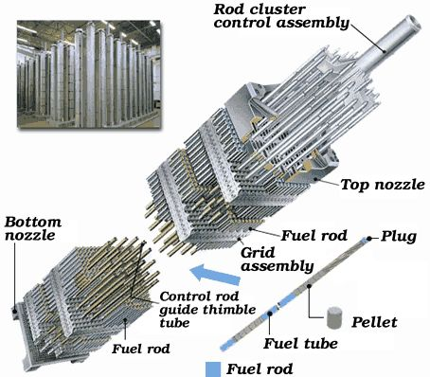
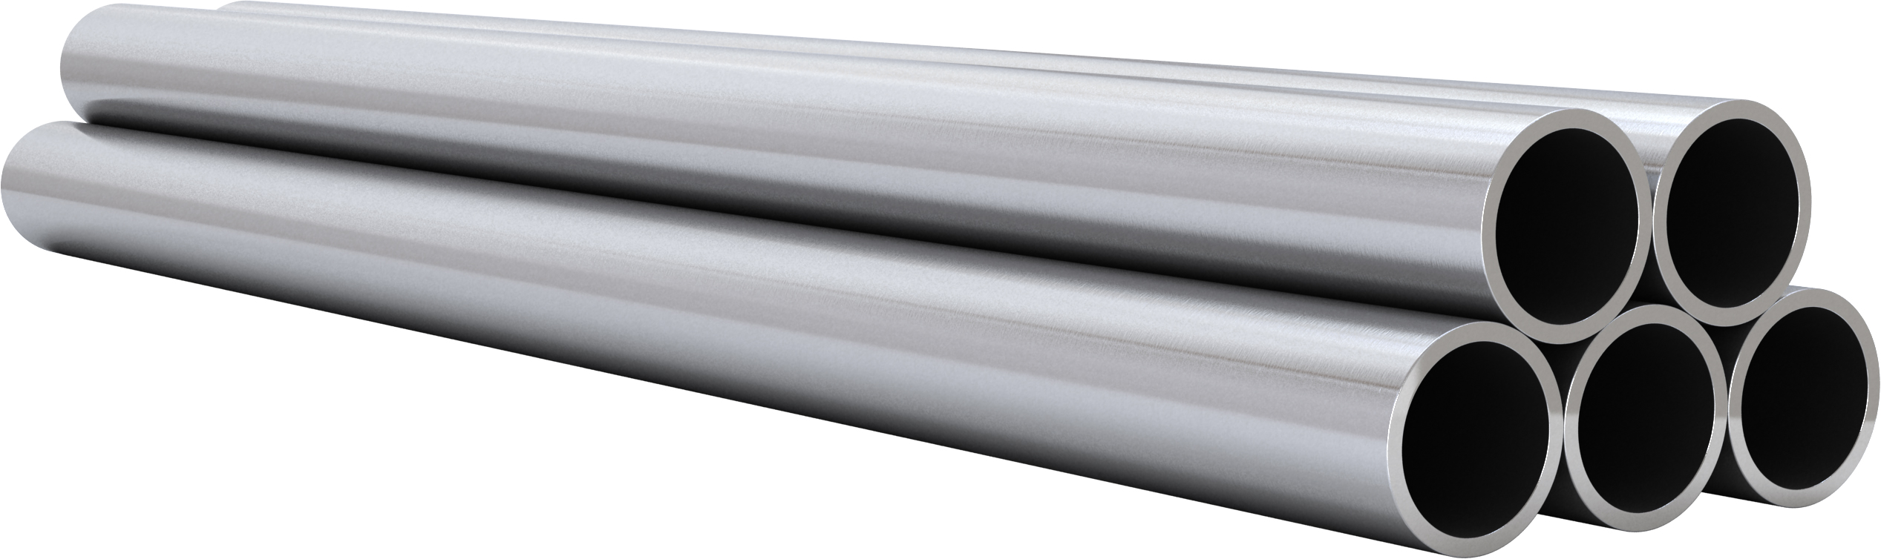
Cladding
The purpose of the cladding is to:
Hold the pellets together so that coolant can freely flow past
Transport heat from fuel to the coolant
Contain fission products
Contain fuel fragments
We would also prefer if the cladding had little to no impact on the neutron transport in the reactor

Slide 30
Why Zirconium alloys?
Benefits
Low neutron cross section
Corrosion resistance in 300˚C water
Resistance to void swelling
Adequate mechanical properties
Good thermal conductivity
Affordable cost
Available in large quantities
Problems?
Corrosion under high temperature steam
Hydride embrittlement
Anisotropic characteristics lead to creep and growth

Slide 31
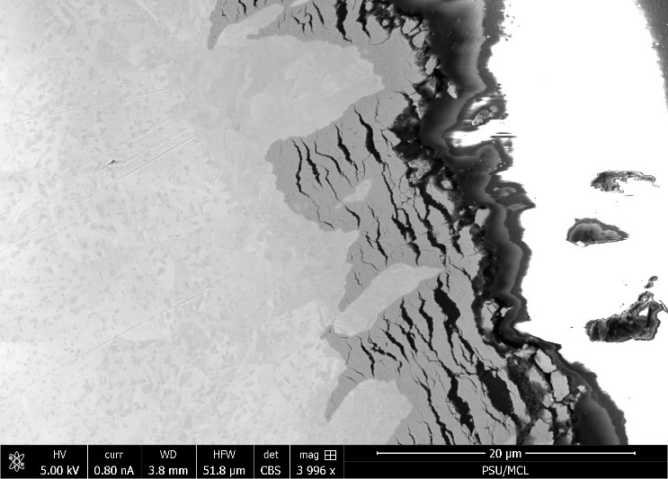
Zirconium
Pure zirconium was not acceptable due to its oxidation behavior
Oxygen with water reacted to form an oxide layer
The oxide layer is brittle and flakes off, allowing more oxidation to occur
Zr alloys were developed to reduce corrosion resistance

Slide 32
Commercial Zr Alloys in PWRs
Alloy | Sn % | Nb % | Fe % | Cr % | Ni % | O %
PWRs (structural components and fuel rods)
Zircaloy-4 (SRA) | 1.2-1.7 | - | 0.18-0.24 | 0.07-0.13 | - | 0.1-0.14
ZIRLO (SRA) | 1 | 1 | 0.1 | - | - | 0.12
Optimized ZIRLO (pRXA) | 0.7 | 1 | 0.1 | - | - | 0.12
M5 (RXA) | - | 0.8-1.2 | 0.015-0.06 | - | - | 0.09-0.12
HPA-45 (SRA/RXA) | 0.6 | - | Fe+V | - | - | 0.12
NDA (SRA) | 1 | 0.1 | 0.3 | 0.2 |  | 0.12
MDA (SRA) | 0.8 | 0.5 | 0.2 | 0.1 |  | 0.12
PRXA Partial Recrystallization Anneal
RXA Recrystallization Anneal
SRA Stress-Relief Anneal

Slide 33
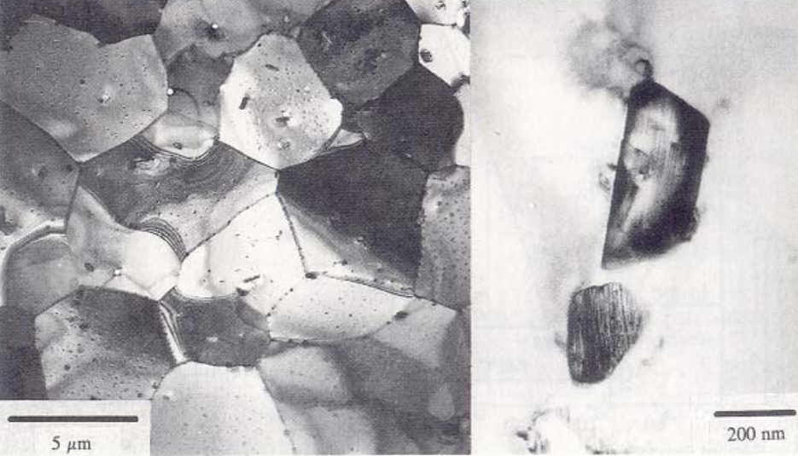
Alloying Elements
The alloying elements impact the microstructure of the material
The intermetallic precipitates significantly improve the oxidation behavior
In Zircaloy 2, the precipitates are
Zr(Cr, Fe)₂
Zr₂(Ni, Fe)
In Zircaloy 4, the precipitates are
Zr(Cr, Fe)₂
Phosphides (Zr₃P) and silicides (Zr₃Si) are also occasionally found
The precipitate distribution, size, morphology, and composition all impact the properties of the material

Slide 34
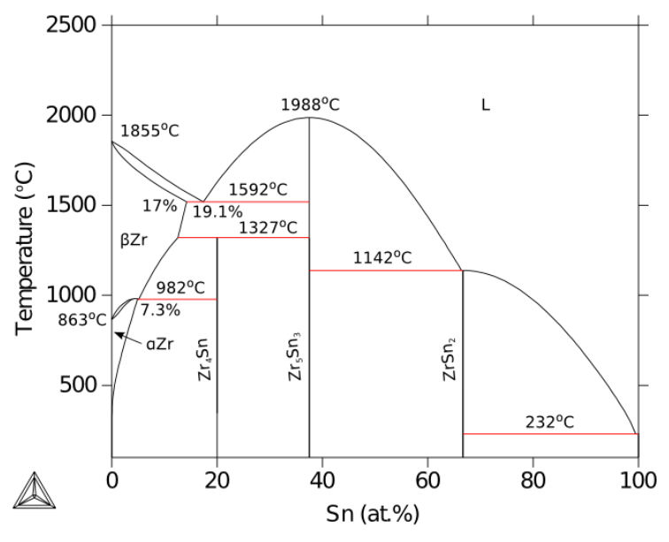
Zirconium Phases
The α-Zr phase has a hexagonal-close-packed (HCP) structure
At temperatures below about 863ºC
Has the most desirable properties
The β-Zr phase has a body-centered cubic (BCC) structure
We try to avoid this phase

Slide 35
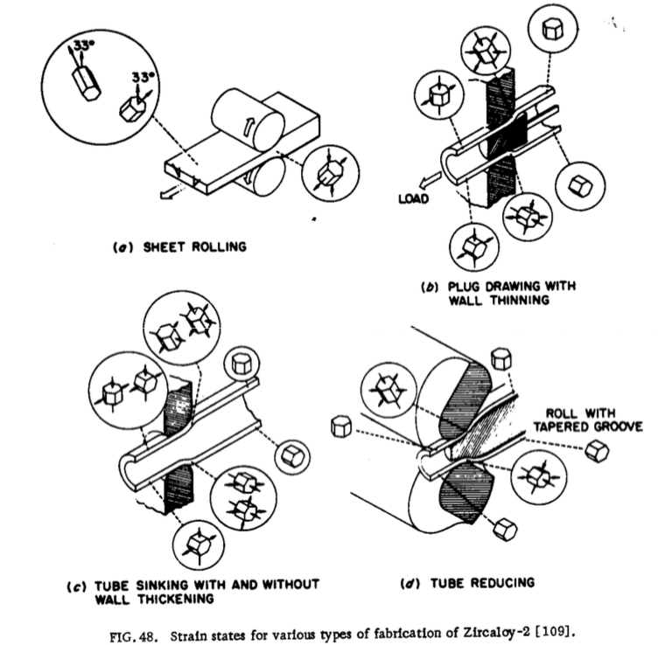
Zr Tube Fabrication
The cladding tubes are fabricated using various processes that SEVERELY deform the material
The severe plastic deformation causes significant dislocation hardening, that can make the tube material too brittle
Plastic deformation along slip planes results in reorientation of the grains
The properties of the material are controlled by heat treatment
Raising the temperature, but below 863˚C, anneals the sample to reduce cold work (stress-relieved)-SRA
Raising the temperature above 863˚C changes to the β phase. They then quench the sample to create a random texture in the α phase-RXA or pRXA

Slide 36
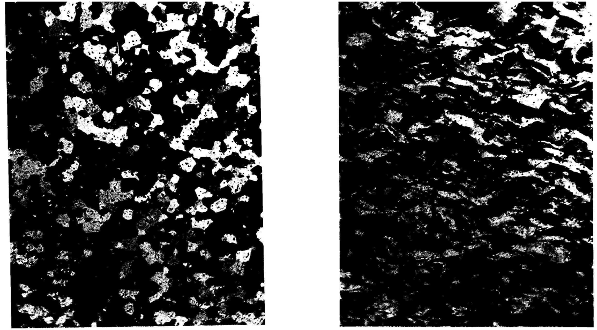
Zr alloy microstructures
Fully recrystallized after quench
Stress-relieved microstructure

Slide 37
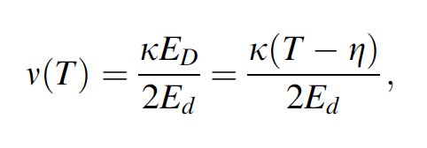
Zirconium Creep and Growth
The cladding undergoes a very large amount of irradiation during its life, the main effects are:
Interstitial loops form on prism planes
Later in the reactor exposure, vacancy loops form on the basal plane
The overall number of displacements to the cladding can be calculated with the NRT model to be ~ 8 x 10⁻⁸ dpa/s, which, over 3 years exposure gives a total of ~8 dpa (every atom in the solid is displaced on the average eight times)

Slide 38
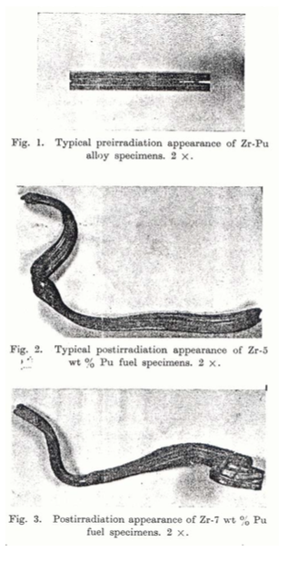
Irradiation Growth
Irradiation growth results from material anisotropy
There must be anisotropy in the defect behavior within the unit cell
There also must be a texture formed in the grain orientations
Interstitial loops form on pyramidal planes, causing shrinkage along the center axis
Later, vacancy loops form on basal planes, making it even worse
The result is a change in shape, shrinking in the 0001 direction and expanding in the pyramidal direction

Slide 39
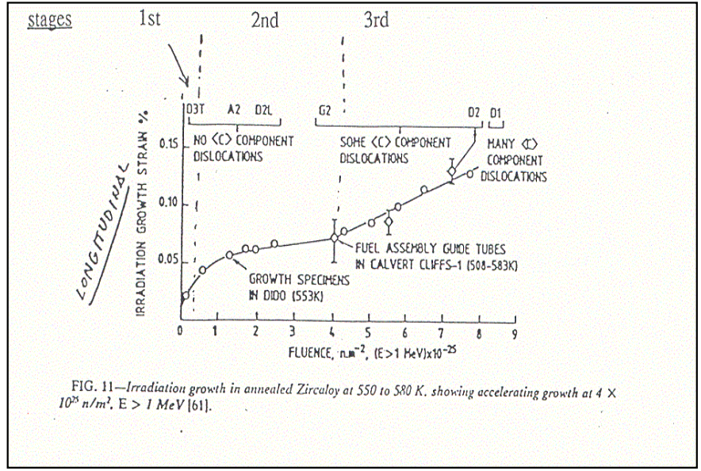
Irradiation Growth
Three stages of irradiation growth
Initial rapid growth to small strains
Slow growth, gets skipped in cold worked material
Accelerated or breakaway growth, caused by formation of vacancy loops on the basal plane
Irradiation growth is affected by:
Fluence, Cold work, Texture, Irradiation temperature, Material chemistry, Hydrogen effects

Slide 40
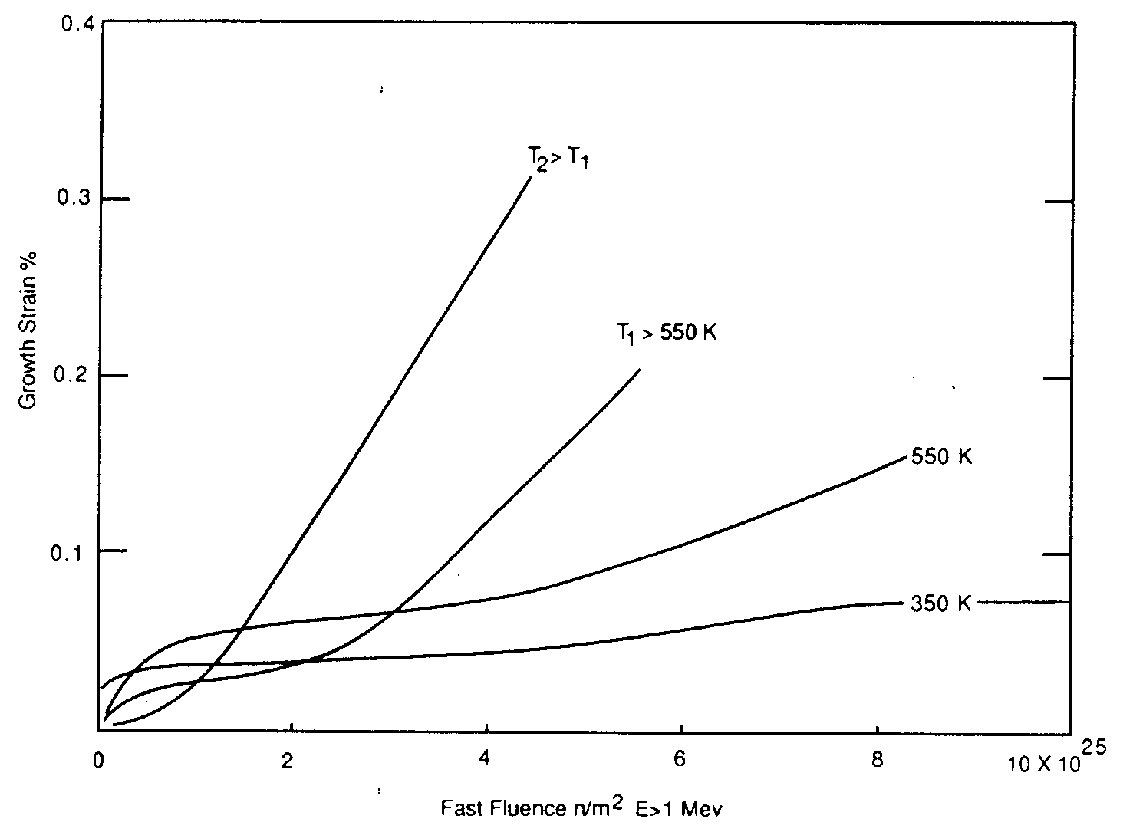
Irradiation Growth
Higher temperature leads to earlier breakaway and higher growth
Higher temperature adds mobility to defects, allowing them to diffuse faster, form clusters, and exacerbate the defect cluster induced anisotropic growth

Slide 41
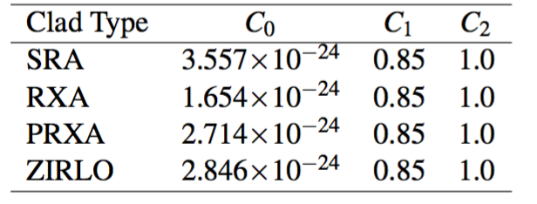
Creep
Empirical models have been developed for thermal and irradiation creep of Zircaloy
Both based on the Von Mises stress
Thermal Creep
With A₀ = 3.14 × 10²⁴ (1/s); shear modulus G = 4.2519 × 10¹⁰ − 2.2185 × 10⁷T Pa; n = 5; Q = 2.7 × 10⁵ J/mol
Irradiation Creep
ϕ is the fast neutron flux n/(cm² s) = 3E11xLHR n/(cm²-s)
Note that SRA stands for stress relief annealed
RXA for recrystallization annealed
PRXA stands for partially recrystallization annealed

Slide 42
Creep Example
Consider an SRA cladding tube at T = 600 K and LHR = 250 W/cm, with a stress σ_{m} = 200 MPa. What is the total creep strain after three years?
First, we will calculate the thermal creep
A₀ = 3.14 × 10²⁴ (1/s)
G = 4.2519 × 10¹⁰ − 2.2185 × 10⁷T Pa = 4.2519e10 − 2.2185e7*600 = 2.92e10 Pa
Q = 2.7 × 10⁵ J/mol, n = 5, R = 8.3144598 J/(K mol)
3.14e24*(200/2.92e4)^5*exp(-2.7e5/(8.3144598*600)) = 1.48e-10 1/s
Now we will calculate the irradiation creep
C₀ = 3.557e-24, C₁ = 0.85, C₂ = 1.0
Φ ≈ 3e11 LHR = 3e11*250 = 7.5e13 n/(cm² s)
3.557e-24*(7.5e13)^0.85*200^1 = 4.43e-10 1/s
The total creep strain rate is 1.48e-10 + 4.43e-10 = 5.91e-10 1/s
The total creep strain after three years is (assuming constant conditions) 5.91e-10*(3600*24*365*3) = 0.056 = 5.6% strain

Slide 43
Creep
Creep impacts fuel performance by shrinking the gap and then conforming to the pellets
a) before “fuel-cladding” interaction: The stress due to coolant pressure exceeds the internal stress from the gap; The diameter decreases due to thermal creep and irradiation creep, where the thermal creep decreases rapidly as irradiation damage builds up; The length increases due to anisotropic creep and irradiation growth

Slide 44
Creep
b) start of “fuel-cladding” interaction: At the contact points the diameter increases, causing some contraction in rod length, and the expanding fuel imparts a local axial tensile stress on the rod, causing an increase in length; Irradiation growth causes an increase in rod length; The net change in length is the sum of the various inputs, but the net is very likely an increase in rod length
c) “fuel-cladding interaction” over most of fuel column: The fuel pellets stress the cladding outward, increasing the diameter of the rod; Anisotropic creep decreases the rod length; Axial pellet-cladding stresses and irradiation growth increase the rod length; The net change in rod length could be positive or negative

Slide 45
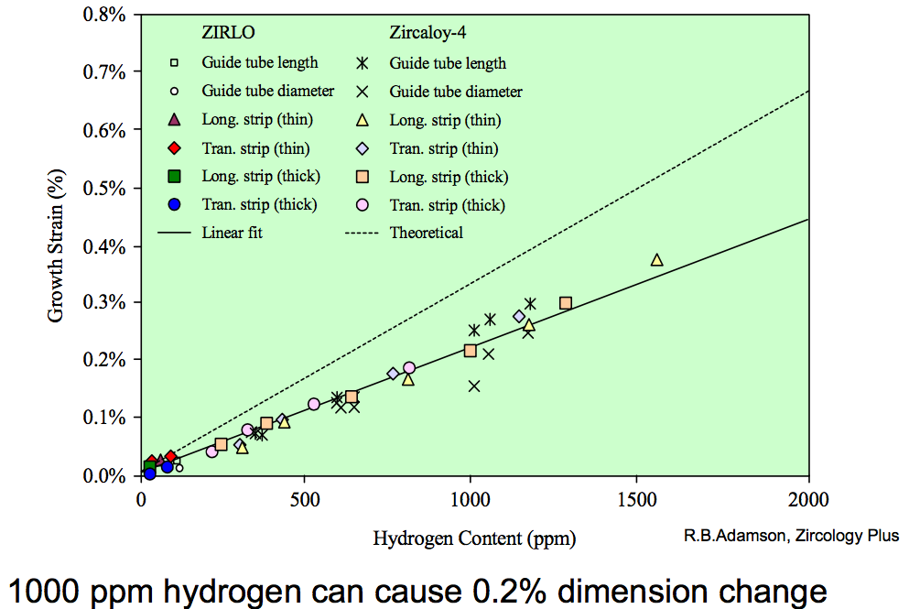
Zirconium Hydrides
Hydrides cause size change because the hydride lattice is larger than the zirconium lattice
There are a number of different Zr-H phases and morphologies that can present
0.1% H can cause 0.2% growth

Slide 46
Summary of Creep and Irradiation Growth
Growth and creep are the major mechanisms for dimensional instability in zirconium alloy cladding
Growth results from the clustering of interstitials on prismatic planes, and eventually from the clustering of vacancies on basal planes such that the material shrinks in the axial direction
Growth depends on the fluence, coldwork, texture, temperature, and composition

Slide 47
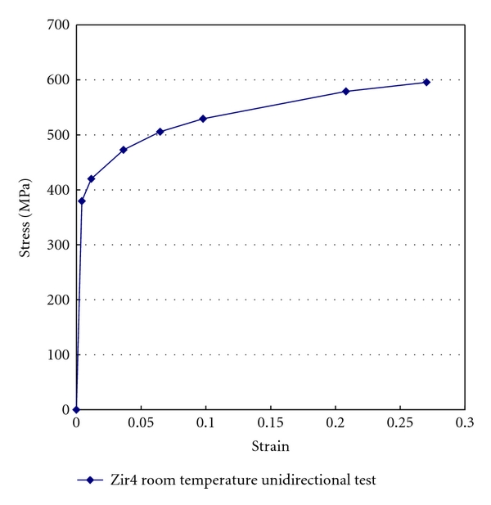
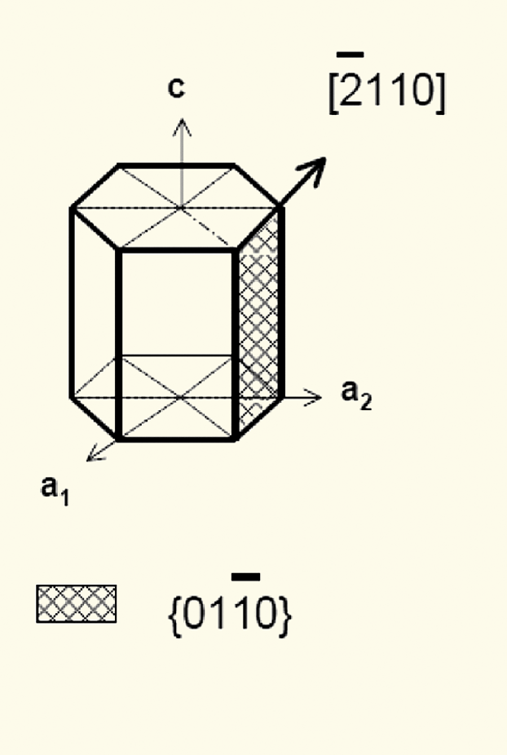
Mechanical Behavior of Zr Cladding
Zirconium alloys plastically deform primarily due to dislocation motion on prismatic planes

Slide 48
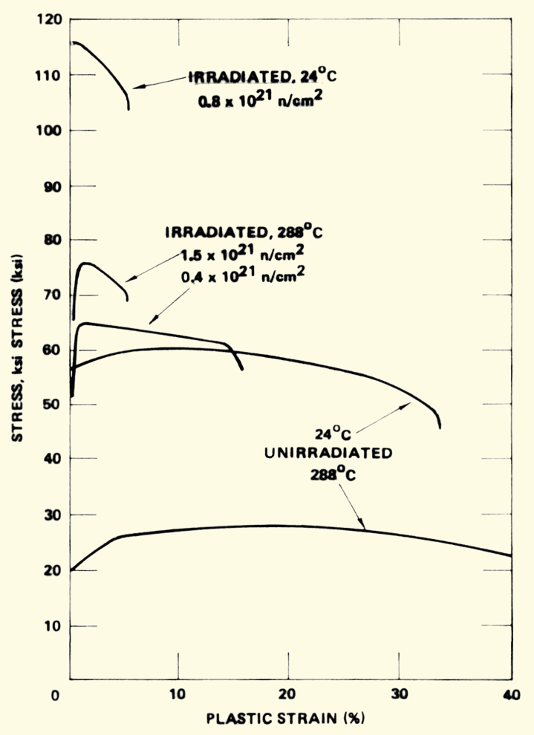
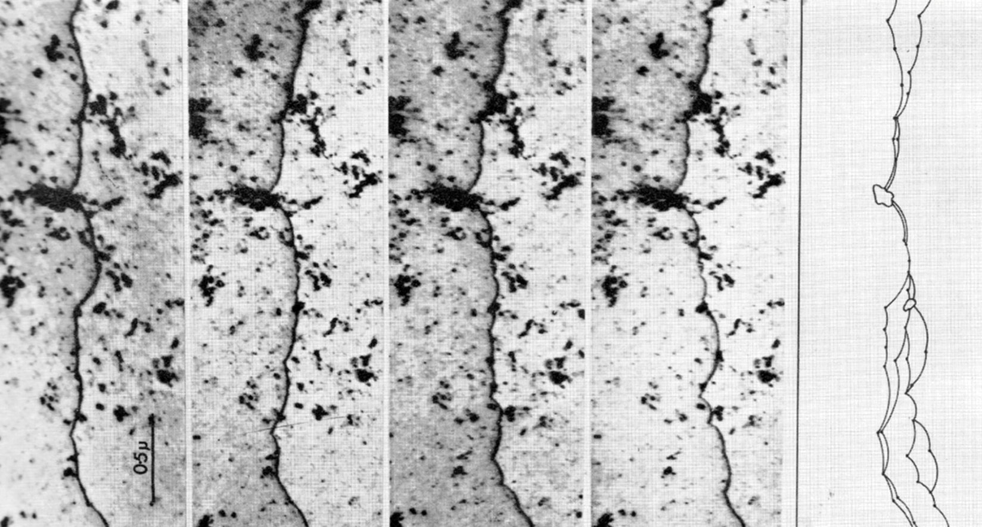
Irradiation Hardening
Under irradiation, the interstitial loops that buildup on the prismatic planes cause hardening
The UTS goes up with fluence, while the strain before fracture goes down
dislocation is moving

Slide 49
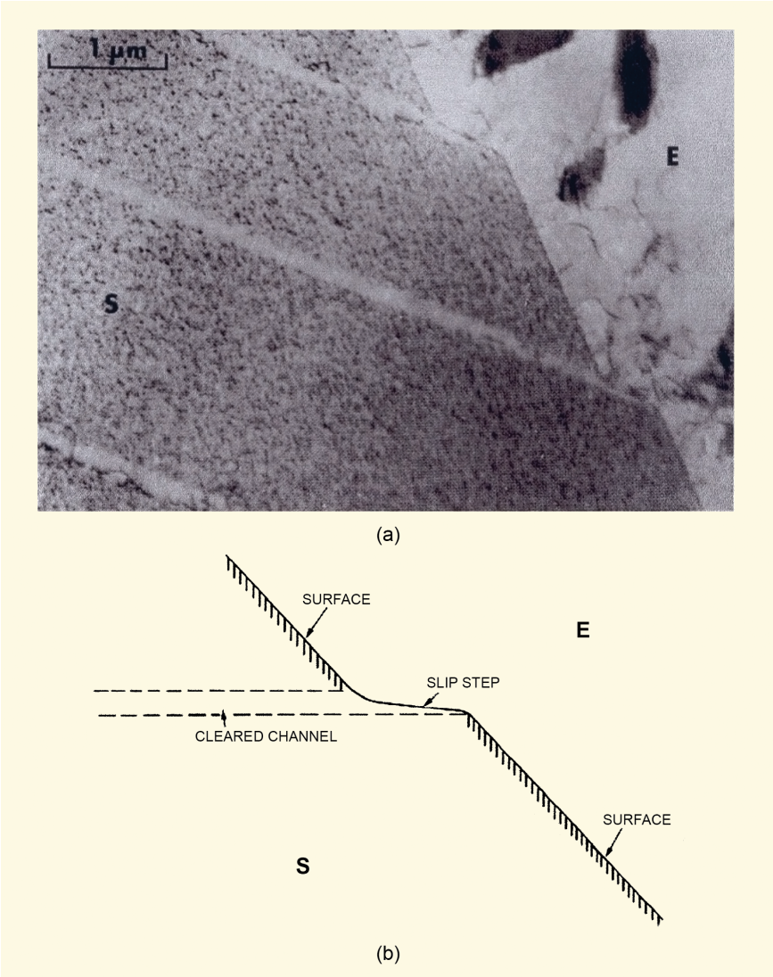
Dislocation Channels
When stress is high enough, loops are “swept away”, forming a clean channel
Once a channel is cleaned out, dislocations continue to move along it
This results in lots of deformation in that one area, creating slip steps
In HCP zircaloy, channels form on basal planes or prism planes depending on
Load direction
Temperature
Oxygen content in the alloy
Fluence

Slide 50
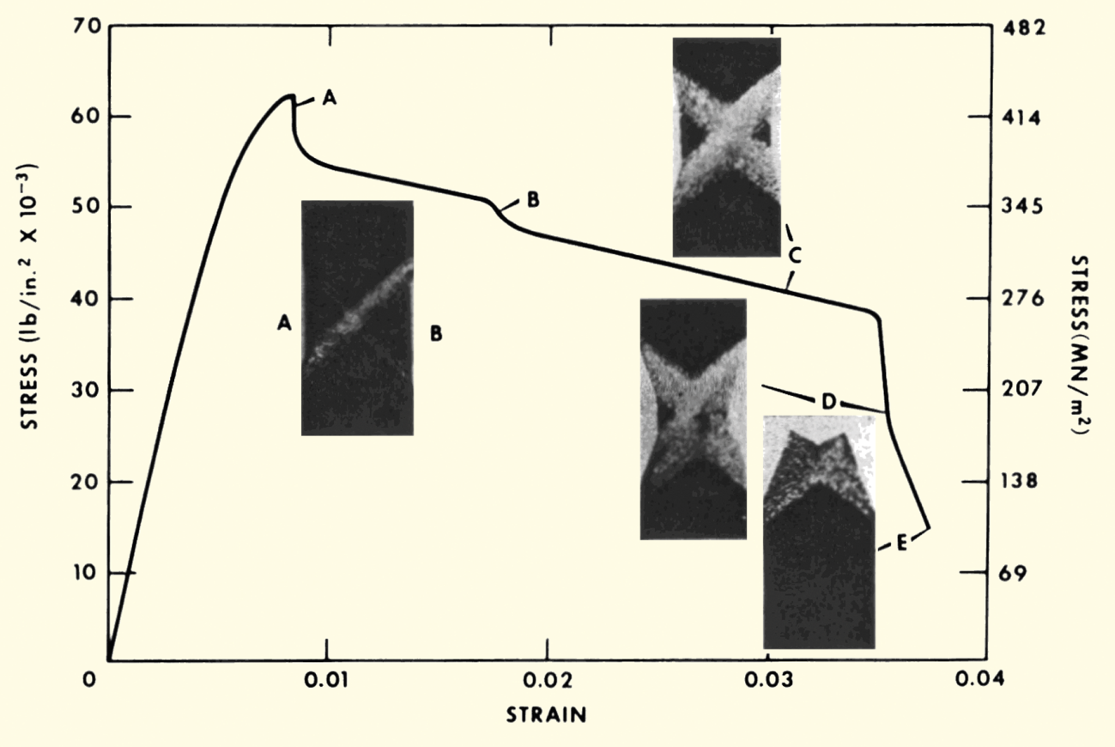
Dislocation Channels
Channel formation is an important behavior in irradiated zircaloy
Dislocation channel deformation occurs at high load or high fluence

Slide 51
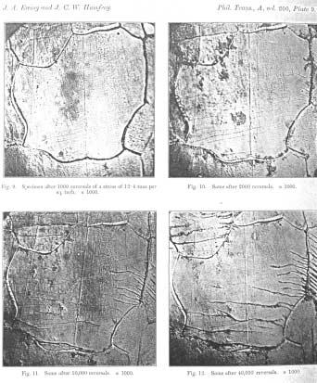
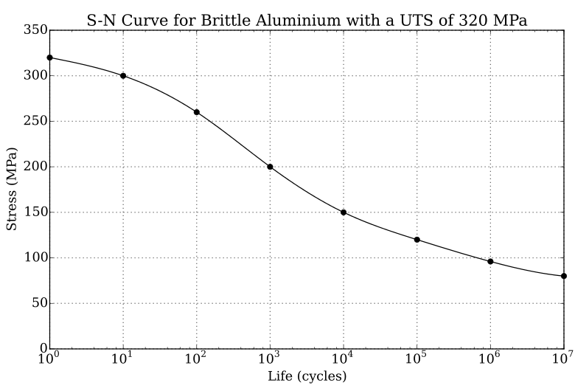
Fatigue
Material fatigue is the weakening of a material caused by repeated applied loads
Materials under cyclic loading can experience brittle like fracture at stresses significantly below their UTS
It is caused by the slow propagation of microstructure damage
The engineering tool for investigating fatigue is the S-N curve
An S-N curve is a graph of the magnitude of the cyclic stress (S) against the logarithmic scale of cycles to failure (N).

Slide 52
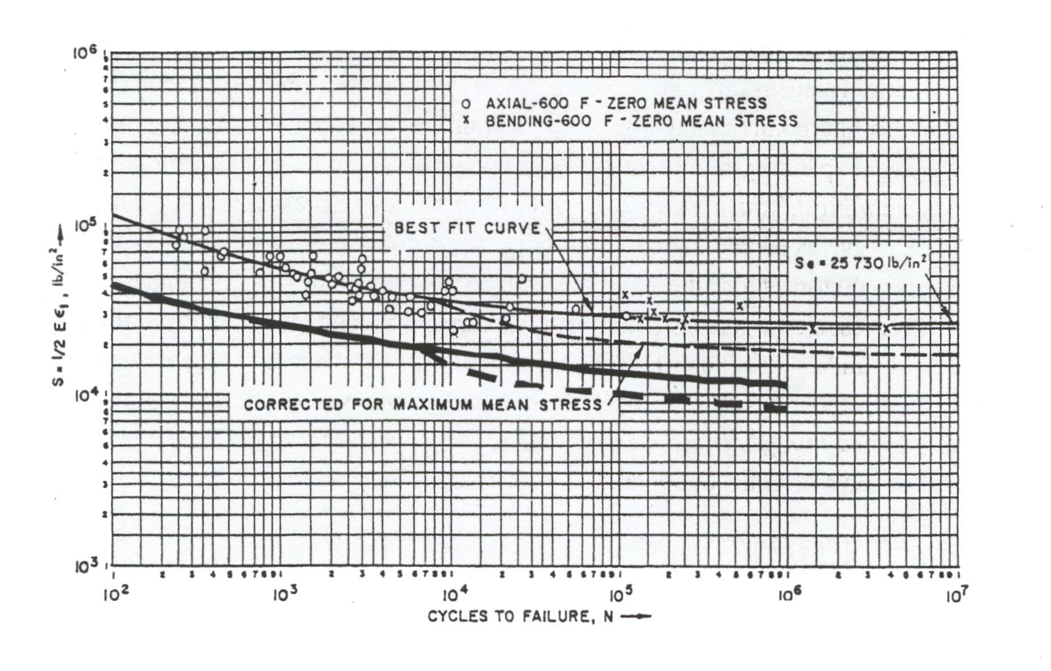
Zr Fatigue
Zircaloy experiences fatigue like other metals
Zircaloy has a fatigue limit at about 10⁵ cycles with 180 Mpa (The UTS is >500 Mpa)
Irradiation slightly lowers the fatigue life in the low cycle range, less than about 10⁴ cycles
Irradiation has no effect on the fatigue life on the high cycle range, greater than about 10⁵ cycles
Design must demonstrate a factor of safety of 2 on stress and 20 on cycles

